Slide 1
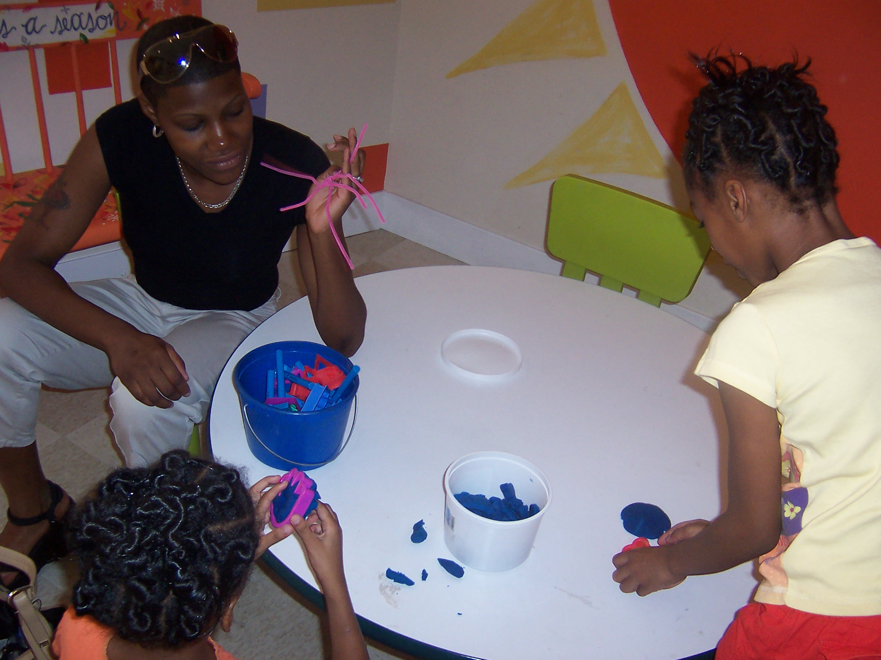
Taking It Home: Activities for teachers AND families
Heather M Duncan MEd

Slide 2
What we know…
The youngest children (and actually EVERYONE!) learn best by…
DOING!

Slide 3
What we know…
Decades of research consistently links family involvement and engagement to higher student achievement…
(Henderson & Mapp, 2002; Weiss, Bouffard, Bridglall, & Gordon, 2009)

Slide 4
How can we…
foster growth in a developmentally appropriate way?
encourage our families to do the same?
We can do great things with kids!

Slide 5
So…what makes a great classroom activity for 2s?
It should be:
fun
“educational”
simple

Slide 6
Now, let’s talk…
Brainstorm two classroom activities that fit our needs…
3 minutes

Slide 7
How do we plan a great classroom activity?
Resources to use:
Books (The Creative Curriculum!)
The internet (Pinterest, Twitter…)
The kids themselves

Slide 8
Cornstarch Oobleck
What you need:
Cornstarch
Water
Food Coloring
Bowl or storage container
What you do:
-Pour cornstarch into the container.
-Slowly add water, stirring with your hands.
-Add just enough water so that the mixture will flow very slowly. If it doesn’t feel firm, add more cornstarch.
-Add drops of food coloring and mix to desired color.
-Squish and enjoy!
See a great video at: http://www.youtube.com/watch?v=XbWBkwM1WAI

Slide 9
So…what makes a great at home activity for 2s?
It should be:
fun
“educational”
simple

Slide 10
How do I share classroom activities with families?
Create a “crib sheet”
Talk it up
Demonstrate
Notes:
-create a crib sheet
-talk it up (if an activity is very popular with kids, let families know)
-demonstrate (if necessary, do a very short in-service teaching how to recreate the activity at home

Slide 11
So…how do we take Oobleck home? In a bag!
What you need:
Cornstarch
Water
Food Coloring
Freezer bags
What you do:
-Pour cornstarch into the bag.
-Slowly add water, mixing by squishing the bag.
-Add just enough water so that the mixture will flow very slowly. If it doesn’t feel firm, add more cornstarch.
-Add drops of food coloring and mix to desired color.
-Seal the bag with packing tape
-Squish and enjoy!
Notes:
Set up a table near the door manned by a teacher who repeats the steps as a demo for parents arriving for pick-up
Show both ways, modify the method a little for those parents who don’t want the mess.
Have printed copies of the recipe (with both methods, pictures and an oobleck starter kit if you can) to share

Slide 12
Now, let’s talk…
Brainstorm ways to modify the activities we listed before to be home friendly…
OR
Devise two classroom activities that will be!
5 minutes

Slide 13
Questions?

