Slide 1
Systems For Success: Setting the Stage for Reflective Practice
Heather M Duncan
Preschool Teacher
South Shore Fine Arts Academy

Slide 2
We can’t control a lot of what happens in our schools as a whole or in our students’ lives, but we CAN control what WE can control…
How can we do it?
STANDARDIZE!
Notes:
-Especially in Early Childhood, one size fits all should be taboo, but there are times when we don’t need to re-invent the wheel. We can set up action plans for executing our plans just as we do for lessons and other classroom activities.

Slide 3
Why standardize?
As we begin to standardize systems for ourselves –setting up protocols to use year after year- we are forced to think about how we manage our work and why…
Notes:
-Teaching for so many years has informed every aspect of my life and impacted it in a positive way. I’ve spent a lot of time figuring out how to make sure I’m not reinventing the wheel every single year.

Slide 4
Objectives
At the end of this session you will be able to begin:
planning effective ways to review and reflect on feedback from various sources…
devising a method to identify and set goals…
creating actionable next steps toward reaching those goals

Slide 5
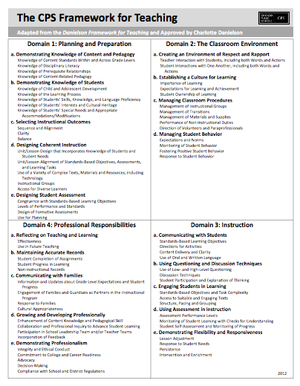
Effective reflection and use of feedback is an excellent way to work toward “Distinguished” ratings in all Domains of The CPS Framework for Teaching, especially Domain 4, Professional Responsibilities!

Slide 6
Reviewing Feedback
Reflect and Learn System
Watch for an email from your administrator
Access the Reflect & Learn system
Read about your observation
CLASS
Watch for an email from OECE
Access your report
Notes:
This is the hard part to standardize…we have to wait to receive the information we need, but when we get it, we can spring into action.

Slide 7
Reflecting on feedback
Decide how to record your thoughts
electronically in an application
by hand with written notes
Read the entire item carefully and without distractions
Go back and take notes on:
where you would like to push back
“opportunities” which you will use to improve practice
Notes:
-Reading and digesting the entire item before trying to respond will help you look at a big picture before deciding which parts to work on.
-Actually recording these ideas is important, it helps us frame our thoughts so that we can decide how to move forward

Slide 8
Taking notes
Electronically
within the Reflect & Learn system
in a document (MS Word, Pages or Google doc)
in a note-taking app
Handwritten
in a designated space like a classroom notebook
in your Reflective Practice Journal
Notes:
Set a time and place
We used to have Fridays to work on tasks like these, but that’s over. Depending on how your time is distributed, you can use preps/planning time, the gap between half day classes or time immediately after school. I try to get it done in the classroom so that I can start using what I learn right away.
Decide how to record your thoughts
-Choose a way to get this done and try it, then try another way the next time. Decide on a way that works best for you, don’t be afraid to try different things until you find a fit, and conversely don’t be afraid to stick with what works. A Word doc may work for you, or maybe you prefer a notebook. Do you need a blank page to just jot it all down, or do you want to create a form with spaces for different ideas? This is also a good time to try the Reflective practice journal from OECE which we will discuss at the end of the session.
I like Google Docs because I can do them on my iPad, personal computer or school computer, even my phone if I want.

Slide 10
So let’s talk…
How have YOU done it?
How CAN you do it?
Notes:
Turn and talk OR reflect and jot notes to share

Slide 11
Identifying “Opportunities”
Look at the feedback & decide:
What’s pressing for my class/team school?
How do I want or need to grow?
Pick one!
Notes:
Sometimes these will be the same, sometimes not. Only you can decide what will help you be the best teacher you can be, but trying to spread your focus to too many things seldom results in success. You can make a list of things to work on, but attack them one at a time.

Slide 12
Setting Goals
Try the Lululemon method…
“Your VISIONdefines your ideal…and identifies the GOALS you'll need to get there. Through goal setting, you get down to the nitty-gritty of what you need to do - and when you need to do it by – to [reach that] ideal.”
Notes:
I’ve been trying this outside of work…What’s your vision for yourself or your classroom as it relates to the feedback? Use that vision to set your goal or goals.

Slide 13
Setting Goals
Try the Lululemon method…
Your vision:
provides focus
helps you discover your personal path
Your goals:
inspire you to do the work
excite and even scare you
are specific, measurable and written in the present tense

Slide 14
So let’s talk…
How have YOU done it?
How CAN you do it?

Slide 15
Choosing Next Steps
You know your goal, so…
What do you need to do to reach it?
How will you know when you have?
Notes:
Make a list or an outline. If you need serious visuals make a chart or a vision board. Set an end date when you’ll do a check in.

Slide 16
Taking the steps
Take a few days to do research and collect resources, then:
Make a plan and carefully execute it…
choose a start date
add it to your lesson plans
OR…
Just DO it!
Notes:
Do you need to improve feedback loops? Want to punch up your small groups? Could your lesson plans use a link to standards? Ask colleagues, use Pinterest or just Google keywords related to your goal. Take something that appeals to you or that you can do immediately and do it!

Slide 17
So let’s talk…
How have YOU done it?
How CAN you do it?

Slide 18
Staying the course
Collect resources
Review your goals
Revise the goals
Repeat
Notes:
Review your goals at the end date
If necessary, revise the goals
Repeat from the beginning

Slide 19
So let’s talk…
How have YOU done it?
How CAN you do it?

Slide 20
Now what?
?
Notes:
Let’s take a look at what the OECE suggests…

