Slide 1
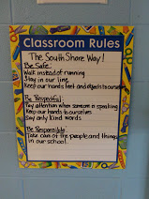
Systems For Success: Setting up for meaningful communication with children, families and administrators Heather M Duncan MEd South Shore Fine Arts Academy

Slide 2
Think of 3 words that describe how you feel about communication in your classroom and/or school.
Text 372696 and your message to 37607

Slide 3
We can’t control a lot of what happens in our schools as a whole or in our students’ lives, but we CAN control what WE can control…
How can we do it?
STANDARDIZE!
Notes:
-Especially in Early Childhood, one size fits all is taboo, but there are times when we don’t need to re-invent the wheel.

Slide 4
Why standardize?
As we work to standardize systems for ourselves we are forced to be clear about the messages we are trying to convey.
Notes:
-Working with the youngest children has informed every aspect of my life and impacted them in a positive way. I’ve spent a lot of time figuring out how to make sure I’m not saying more than I need to say.
-When I started writing one page resources for families and colleagues to use, I realized that even for them I HAD to keep it short, sweet and clear, but it started with the kids…and my love of outlines

Slide 5
Objectives
At the end of this session you will be able to begin:
planning appropriate and effective ways to communicate with students
setting up your classroom and yourself to communicate clearly with families
finding, choosing and developing resources to share with administrators to help them understand what happens in ECE classrooms

Slide 6
For Students….
Notes:
In classrooms, good directions are the best way to ensure that students work toward clear goals and meet expectations. Simple, clear instructions are imperative and the critical foundation of their learning. Such instructions can easily be shared as visuals in the classroom because they:

Slide 7
Use Visuals To Communicate Directions To Students
Good directions:
Are short and concise
Are easy to follow and remember
Clearly convey expectations/goals
Notes:
There are dozens and dozens of routines that we use with children every day…you are probably already standardizing a lot of what you do. Let’s look at an example of one way that we can use a template, or basic format that will make things easier for them AND for us.

Slide 8
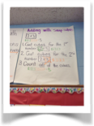
Keep directions short & concise…
Limit to steps to five or fewer.
Notes:
Research shows that two to three step instructions are the most that
people can handle efficiently, so where possible, limit steps to five or
fewer. (An exception: directions for completely teacher led activities -eg:
cooking from a recipe- can be longer or more complex, as the teacher will
visit or revisit any steps with students as they approach.) When sharing
instructions, be sure to begin by verbally and visually enumerating the
steps. Restate numbers for each step as they are shared.

Slide 9
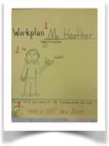
Make them easy to follow and remember…
Use a combination of familiar and novel steps
(And here’s where we standardize!)
Example: Writing a journal entry
1. Write your name at the top of the page (same step as all writing activities)
2. Decide on your topic and draw the picture (novel step 1 to end goal)
3. Dictate or write words with teacher (novel step 2 to end goal)
4. Put journal and writing materials away (same step as all activities)
Notes:
For listeners, too many words become white noise, but
a well balanced combination of familiar and novel
statements will keep students' attention. To share
directions for an activity, try using the same multi-step
format, the same initial step, novel instructions to
reach the end goal of the specific activity and the same
kind of culminating step each time you give directions.

Slide 10
Clearly convey what goal must be met.
Notes:
How do we want this to end? Be explicit.

Slide 11
So let’s talk…
How have YOU done it?
How CAN you do it?

Slide 12
For Families…

Slide 13
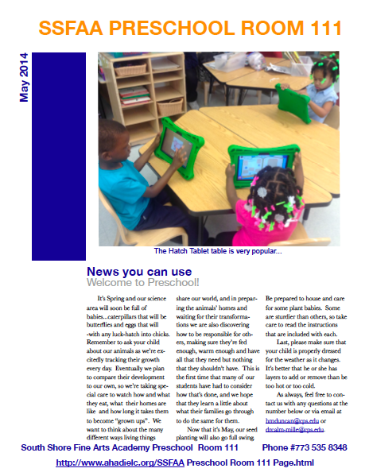
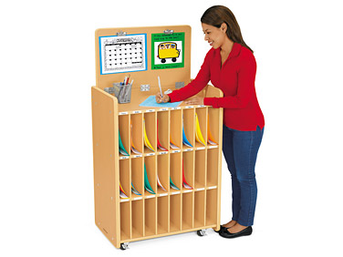
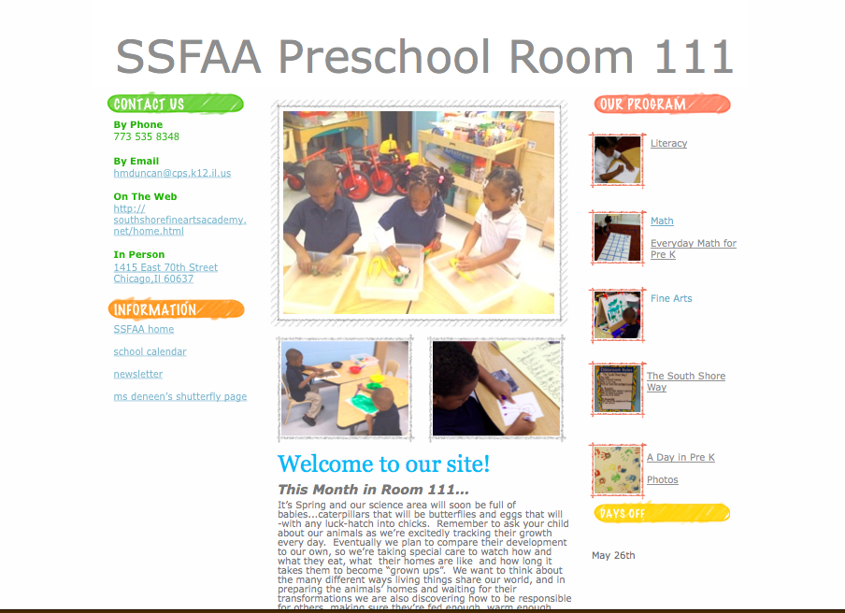
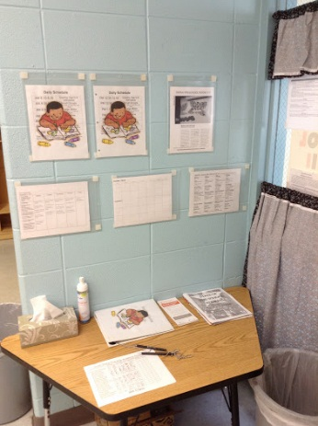
Set up your classroom…
Newsletter
Communication Area Website
Notes:
Set up your classroom
Design a classroom newsletter and send it home regularly (weekly or monthly)
Create a place -or places- to share information
-In the classroom
Communication table/area
-Online
Maintain a website (see an example here: Room 111)
Use photo sharing sites (Shutterfly, Flickr, Photobucket)
Tweet! (twitter.com)

Slide 14
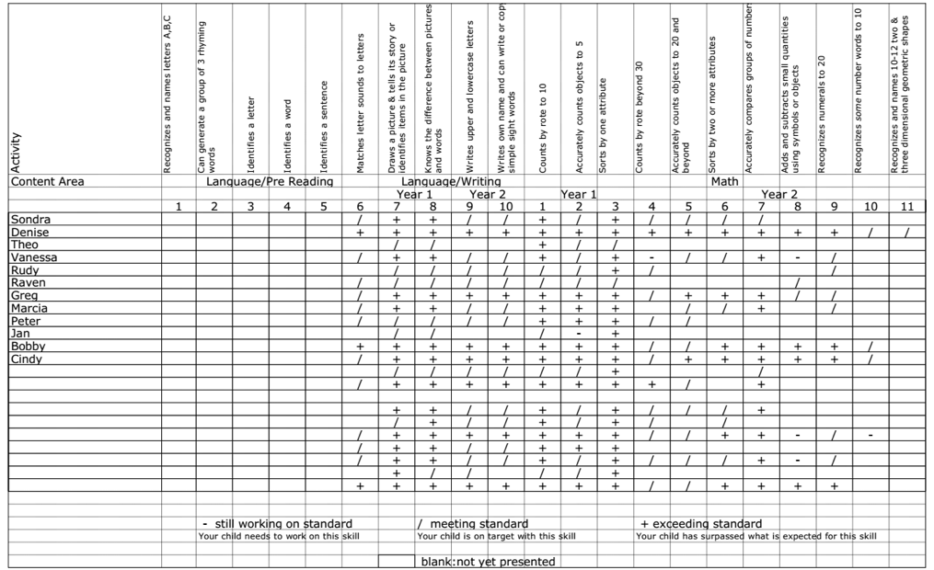
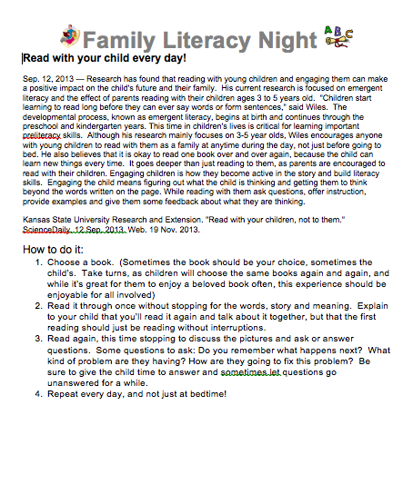
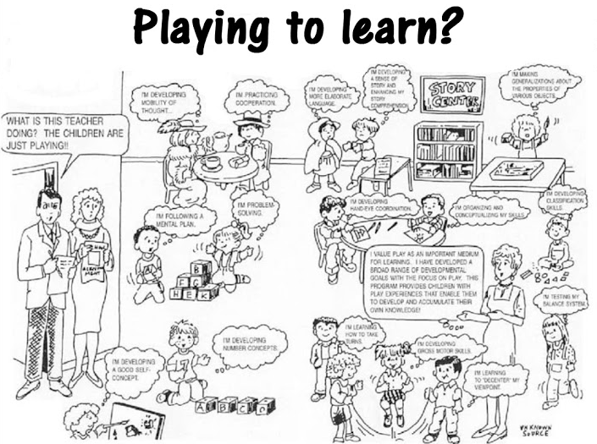
Find or create resources to distribute to parents…
Try using the resources you make to establish open lines of communication (at least on your end!), help families understand what happens at school and engage them in the life of your classroom so that they can support their children.
Checklists Info Sheets Overviews
Notes:
Find or create resources to distribute to parents
There are thousands of great resources online for teachers to share with families, but you will sometimes need to share specifics about your classroom and curriculum. Create your own overviews, checklists and info sheets to keep, tweak and share with families for years. Beyond saving documents to your own computer, you can also save them to a cloud drive (like Google Drive) where they are easily accessed and shared from any computer.

Slide 15
Plan opportunities to share.
Give families at least three big chances each year to see what happens at school. Offer useful handouts explaining key concepts that might otherwise go unnoticed or be misunderstood.
Sample Family Workshop Schedule:
Later in the year, offer drop-in family workshops which allow families to arrive 15 minutes early for pickup time to do an activity with their child.
Sample Drop-In Workshop Ideas:
September | November | January | April
Whole School Curriculum Night/ Open House | This Year In Room 111… | A Day In Pre-K | Family Reading Night
February | March | May | June
Sibling Survey; add to a classroom survey and see where your family fits | Read To Your Bunny: families make a bunny pointer and use it for one to one correspondence while reading | Plant a seed: learn about the 3 things a seed needs to grow, and plant a seed to take home | Share a book; families assemble, read and take home a mini book
Notes:
Plan opportunities to share
Give families at minimum three big chances each year to see what happens at school, one at the beginning and two in the middle. EOY can be used as a celebration of learning, but is not the best time to try to foster understanding. Offer useful handouts explaining key concepts that might otherwise go unnoticed or be misunderstood.

Slide 16
So let’s talk…
How have YOU done it?
How CAN you do it?

Slide 17
For Administrators…

Slide 18
Give them a “head’s up”…

Slide 19
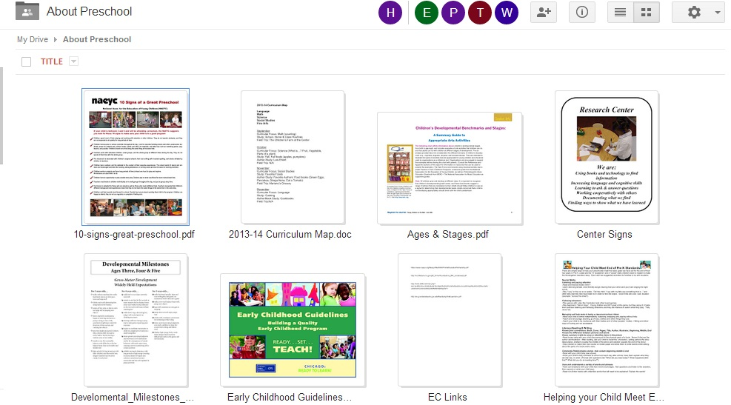
Make sure they understand what they see…
Notes:
An oldie but goodie, in the 90’s EC teachers had to invoke this all the time to explain what we were doing. Collect information to share with your admin that will help them understand what happens in a Pre K room.

Slide 20
Show them what they’re looking for.
Standards
Data
Collaboration
Notes:
YOU know what you’re doing is addressing a standard somewhere…name and show it!
Do your admin LOVE data? Use graphs or tables (eg. a “Can you write your name?” survey where “yes” answers write their names and “no” answers write what they can…instant data.

Slide 21
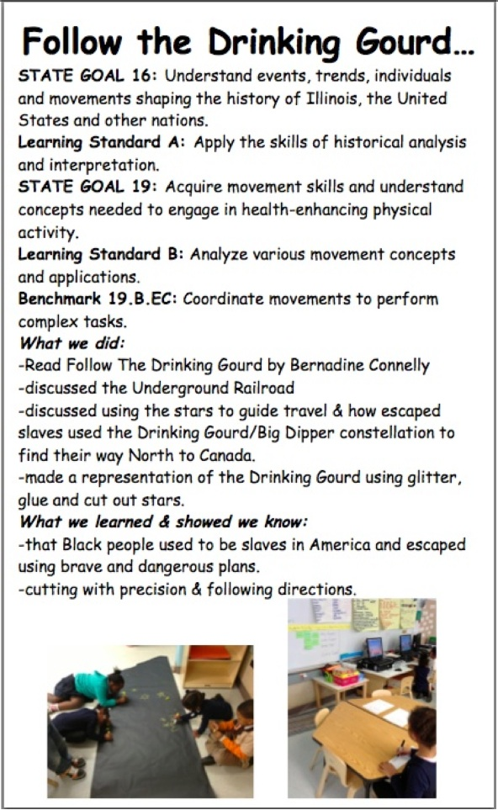
Notes:
Leave the information lying around. Post detailed descriptions of standards met next to displays.

Slide 22
So let’s talk…
How have YOU done it?
How CAN you do it?

Slide 23
Keep in mind…
Be flexible…
Innovate!
Notes:
Be flexible- use templates to make things simpler, but don’t be a slave to them. Make them work for you. That said…
Innovate- having a framework to start from is actually freeing! Use what works, but plug new ideas in every year!

