Slide 1
Welcome To Preschool!:
Getting Started In Room 111
Heather M Duncan
D’Metra Mays

Slide 2
Agenda
Today’s goals:
Discuss:
the importance of family/school communication
ways SSFAA reaches out to families
Learn:
What to expect during your child’s time in Room 111
ways you can keep communication open
Q & A:
what do you still need to know?
Notes:
Heather

Slide 3
Objectives
At the end of this session you will:
know a little about SSFAA, Room 111 & its teachers…
have completed all forms necessary for your child to start Pre K!
Notes:
Deneen

Slide 4
How can we keep the lines of communication open?
Teachers and others at SSFAA will:
Send home a lot of paper!
Ask for your input!
Hope that you attend family conferences and meetings!
Here’s what YOU can do...
Notes:
Heather

Slide 5
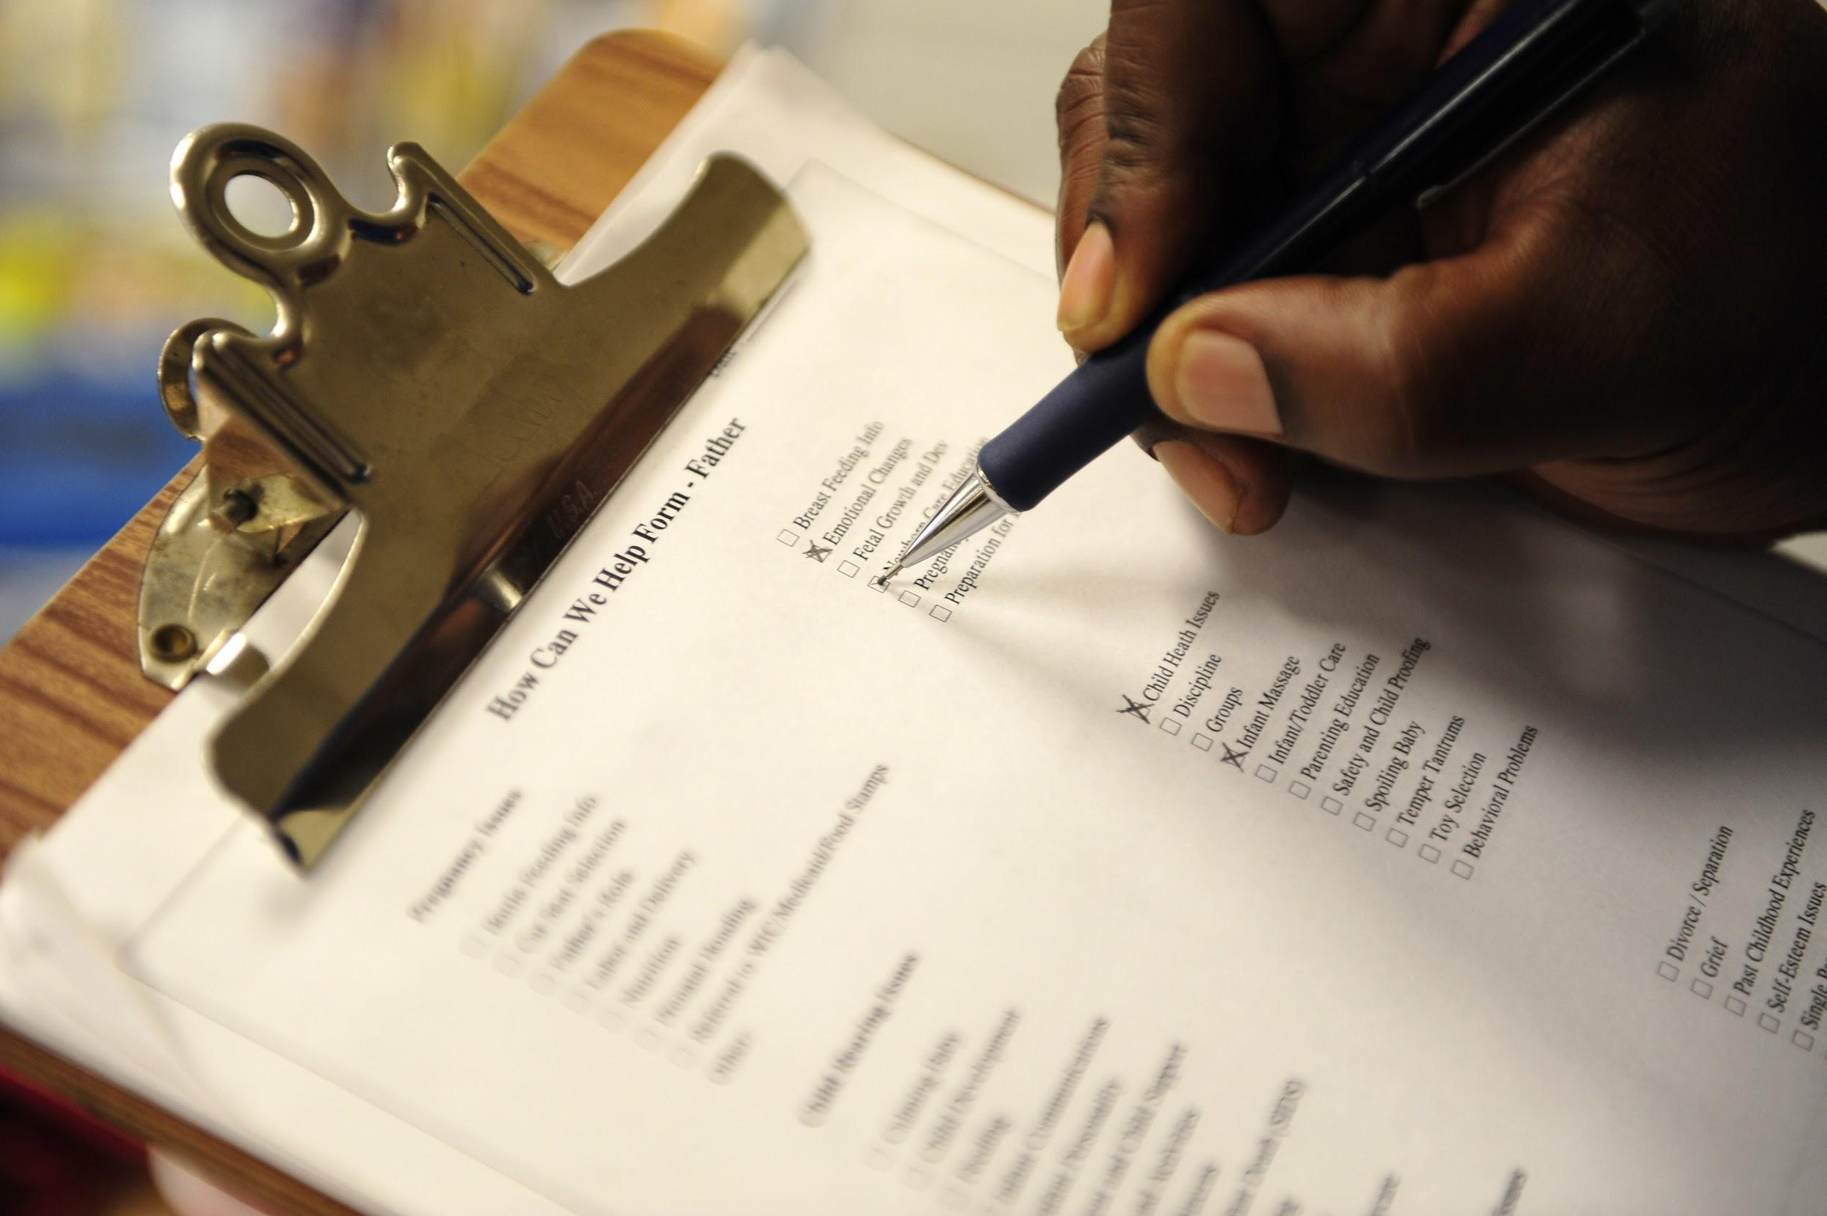
Fill out and return forms as soon as possible
Notes:
Deneen
Handout - BOY questionnaire

Slide 6
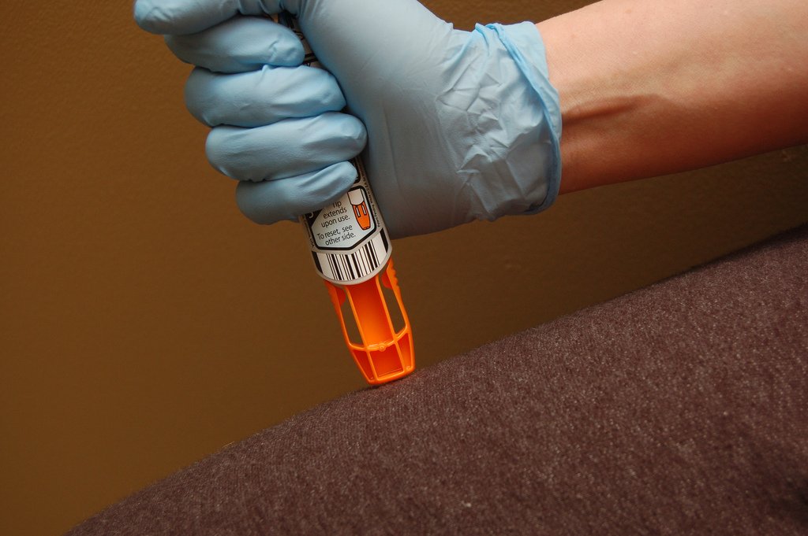
Is there something we need to know about your family? Tell us!
Notes:
Heather
Layla’s story - letter template

Slide 7
Keep contact phone numbers up to date
Notes:
Deneen

Slide 8
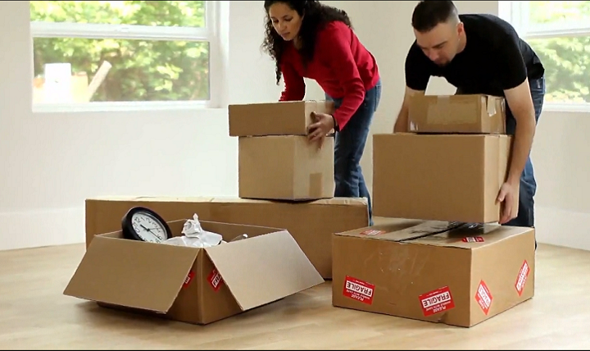
Tell us when something changes for your child
Notes:
Heather
Did the dog run away? Is grandma sick? Are you moving? Did bedtime change?

Slide 9
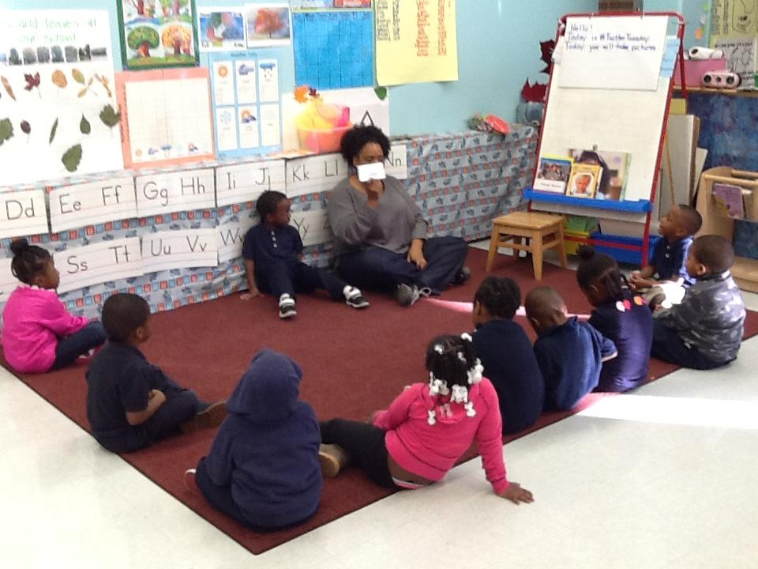
Ask your child about the day at school
Notes:
Heather
Handout -questions to ask

Slide 10
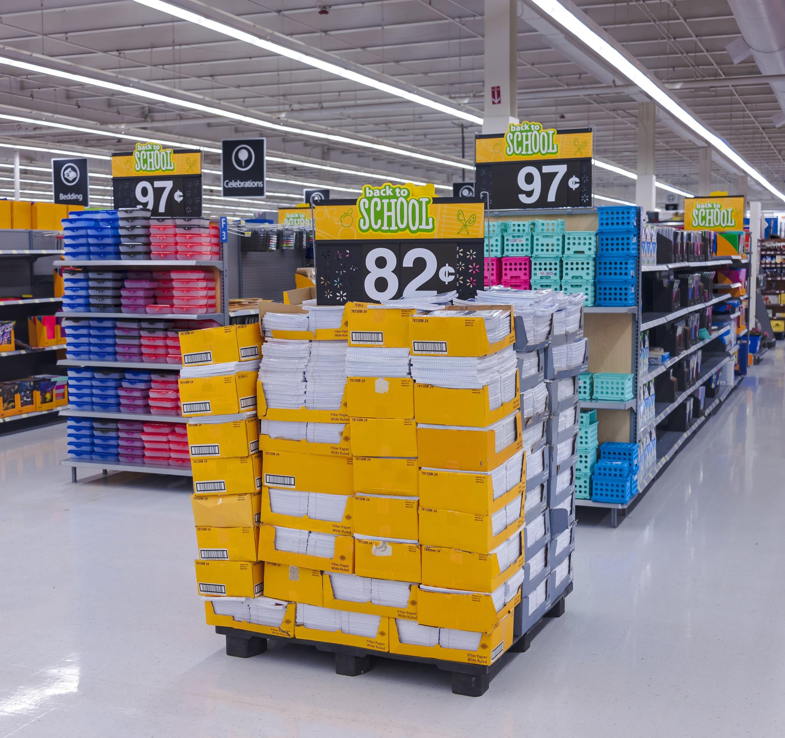
Feel free to ask if donations are welcomed
Notes:
Deneen
Did you see a sale? Do you have extra? Offer it to the classroom!

Slide 11
So...What’s going to happen in Preschool?
Breakfast & Lunch
Dropping-off & signing in/out ON TIME
Be “appropriate” when entering our school
Please put your mobile phone away at drop-off and pick-up!
Notes:
Breakfast & Lunch: we will have breakfast bags in the classroom, don’t bring them in, lunch=cafeteria Dropping-off & signing in/out ON TIME: Teachers need to prepare for the next class, please be on time Be “appropriate” when entering our school: No drinking, no smoking no drugs, no adult language

Slide 12
Advocate for your child, but remember;
teachers are people too!
We make mistakes!
Assume best intentions!
Approach conversations with an open mind and positive attitude!
Notes:
Heather

Slide 13
In Room 111...
We treat each other with courtesy
Kids work & play
There is homework on THURSDAYS only
Everyone learns!

Slide 14
To find out more about what your child will learn in Pre K
Join us for:
Curriculum Night!
Family Math Night!
Family Reading Night!
(Dates are TBA)

Slide 15
Follow The Authentic Preschool on…
Site:
authenticpreschool.net
Facebook:
facebook.com/authenticpreschool.net
Twitter:
@authenticprek
@MsHeatherPreK
Instagram:
theauthenticpreschool
Notes:
Heather

