Slide 1
Heather Duncan
South Shore Fine Arts Academy
Pre K
Collaborating For Success: Working across grade bands to move students AND teachers forward

Slide 2
iTunes U Access!
From your iDevice:
Download the app from the app store.
Click the + sign at the upper left and choose
the “Enroll in a Course” option.
Enter the enroll code: DQZ-MWL-PZ2

Slide 3
Why should teachers collaborate?
Teachers need to work together to…
…align content…
…build your “professional responsibilities” profile…
…keep the faith!

Slide 4
Collaborating within your school to align content
Getting started/reaching out
Get people on board. Start with your grade level team.
Brainstorm together and school wide.
Make plans at start and end of year.
Notes:
Getting started/reaching out
Get people on board. Start with your grade level team because that’s who you have access to.
Brainstorm together and school wide. Are you able to combine grade level meetings?
Make plans at start and end of year. When you have those mandatory meetings at the beginning and end of year, ask admin if you can use some of that time to align.

Slide 5
“Try it!” Time: 20 Minute Collaboration
Brainstorm! Make a list of the 5 most important things you want a student to know when entering your classroom…(2 minutes)
Choose ONE of these as the most important thing for a student entering your classroom to know…(1 minute)
Share!
Outline an activity or lesson that will teach the skill you listed in Step 2 (5 minutes)
Share again! (5 minutes)

Slide 6
Collaborating outside of your school to build your professional responsibilities profile
Find collaborators (Use CPS Weekly Alerts!)
Work with your grade (Grade level PD through CPS University)
Work with everyone (Try a new, all grade level topic. For Summer 2014, check out Googlepalooza! )

Slide 7
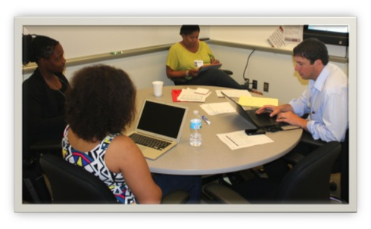
Collaboration is an excellent way to work toward “Distinguished” ratings in Domains 1 & 2, the “behind the scenes” Domains of The CPS Framework for Teaching!

Slide 8
"Try it" time! 10 minute planning
Find and share 3 opportunities you have tried, know about and/or want to try…(5 minutes)
…make a calendar of application due dates…
(4 minutes)
…choose 1-2 to commit to right now!
(1 minute)

Slide 9
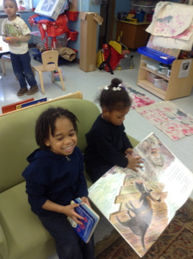
What if you’re still going at it alone?
Collaborate with your kids!
Try again next year!
Next steps?
Get in there!

